Slide 1
Singleton Pattern

Slide 2

Problem
Make sure a class has only one instance at most.
Example: Single error message when multiple errors occurring.
Provide a global access point to the instance.
Global variable may be changed by others.

Slide 3




Solution
Step II
Step IV
Step I
Step III
Check if instance exists.
Create new instance if one does not exist.
Make existing constructor private.
Return existing instance if one exists.

Slide 4
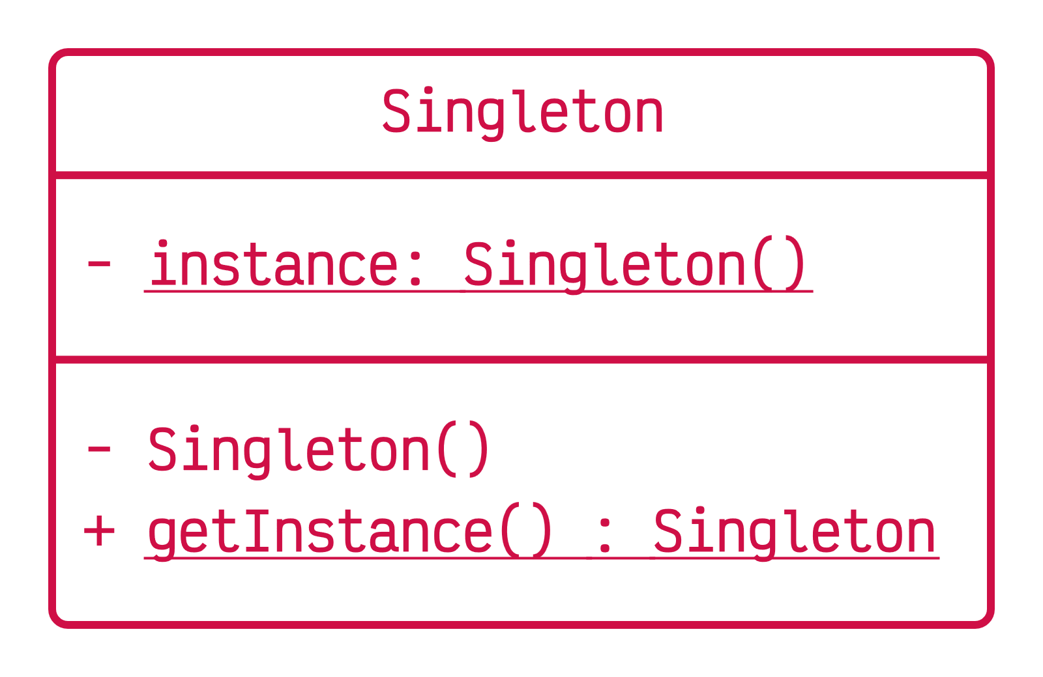
Code
Static method acts as constructor.
Allows access to instance.
class Singleton
{
static private Singleton instance;
private Singleton() {}
public static getInstance()
{
if (instance == null)
instance = new Singleton();
return instance;
}
// other code
}

Slide 5
Pros:
Cons:
Requires special treatment in multithreaded environment.
Creates difficulties while unit testing.
Violates Single Responsibility Principle.
Can’t be certain that more instances won’t ever be needed.
Ensure class only has one instance.
Ensure global access point to that instance.

Slide 6
Thank You

